Slide 1



FINAL PRESENTATION
Maja Schuknecht, Xinyi Miao
Interaction Prototyping
Chair of Ergonomics
TUM School of Engineering and Design
Munich, 08.02.2023

Slide 2






IDEATION
MENSA PAIN POINTS
LONG QUEUES
LITTLE
INFORMATION
RISING PRICES
POOR-TASTING FOOD
reduce queues
improve satisfaction
1
LONG QUEUES: https://www.sueddeutsche.de/image/sz.1.4661477?v=1572443187&format=webp, 2023
RISING PRICES: https://www.pixtastock.com/illustration/87993483, 2023
Notes:
problem/insight
Introductory section: storytelling format, interesting and engaging

Slide 3
IDEATION
OUR SOLUTION
Book in Advance
To Receive
Pre-Booking Discount
Improve Menu & Satisfaction
By Eliminating Poor Dishes
Adapt Order Volumes
For Less Waste and
Improved Availability
Make Informed Choices
Through Graphs,
Ratings & Reviews
1
Notes:
problem/insight
Introductory section: storytelling format, interesting and engaging

Slide 4
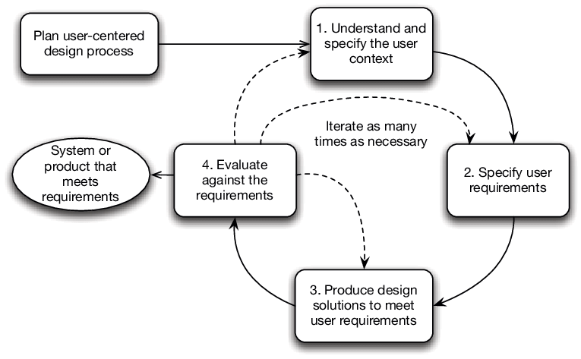
METHODOLOGY
2
https://www.researchgate.net/figure/The-user-centered-design-process-based-on-ISO-9241-2102010-15-p-11_fig1_263429371

Slide 5








METHODOLOGY
ITERATION 1
Interviews
Personas
Scenarios
1. Understand
User Context
Understand context of use
x6
Usability Report ^{[1]}
4. Evaluate
Against Requirements
2. Specify
User Requirements
Specify User Requirements
GOALS
User Goals
reduce waste & costs
3. Design
Solutions
reduce waste & costs
reduce queues
reduce queues
Lo-Fi / Paper Prototype
improve satisfaction
3
https://unsplash.com/images/stock, 2023

Slide 6
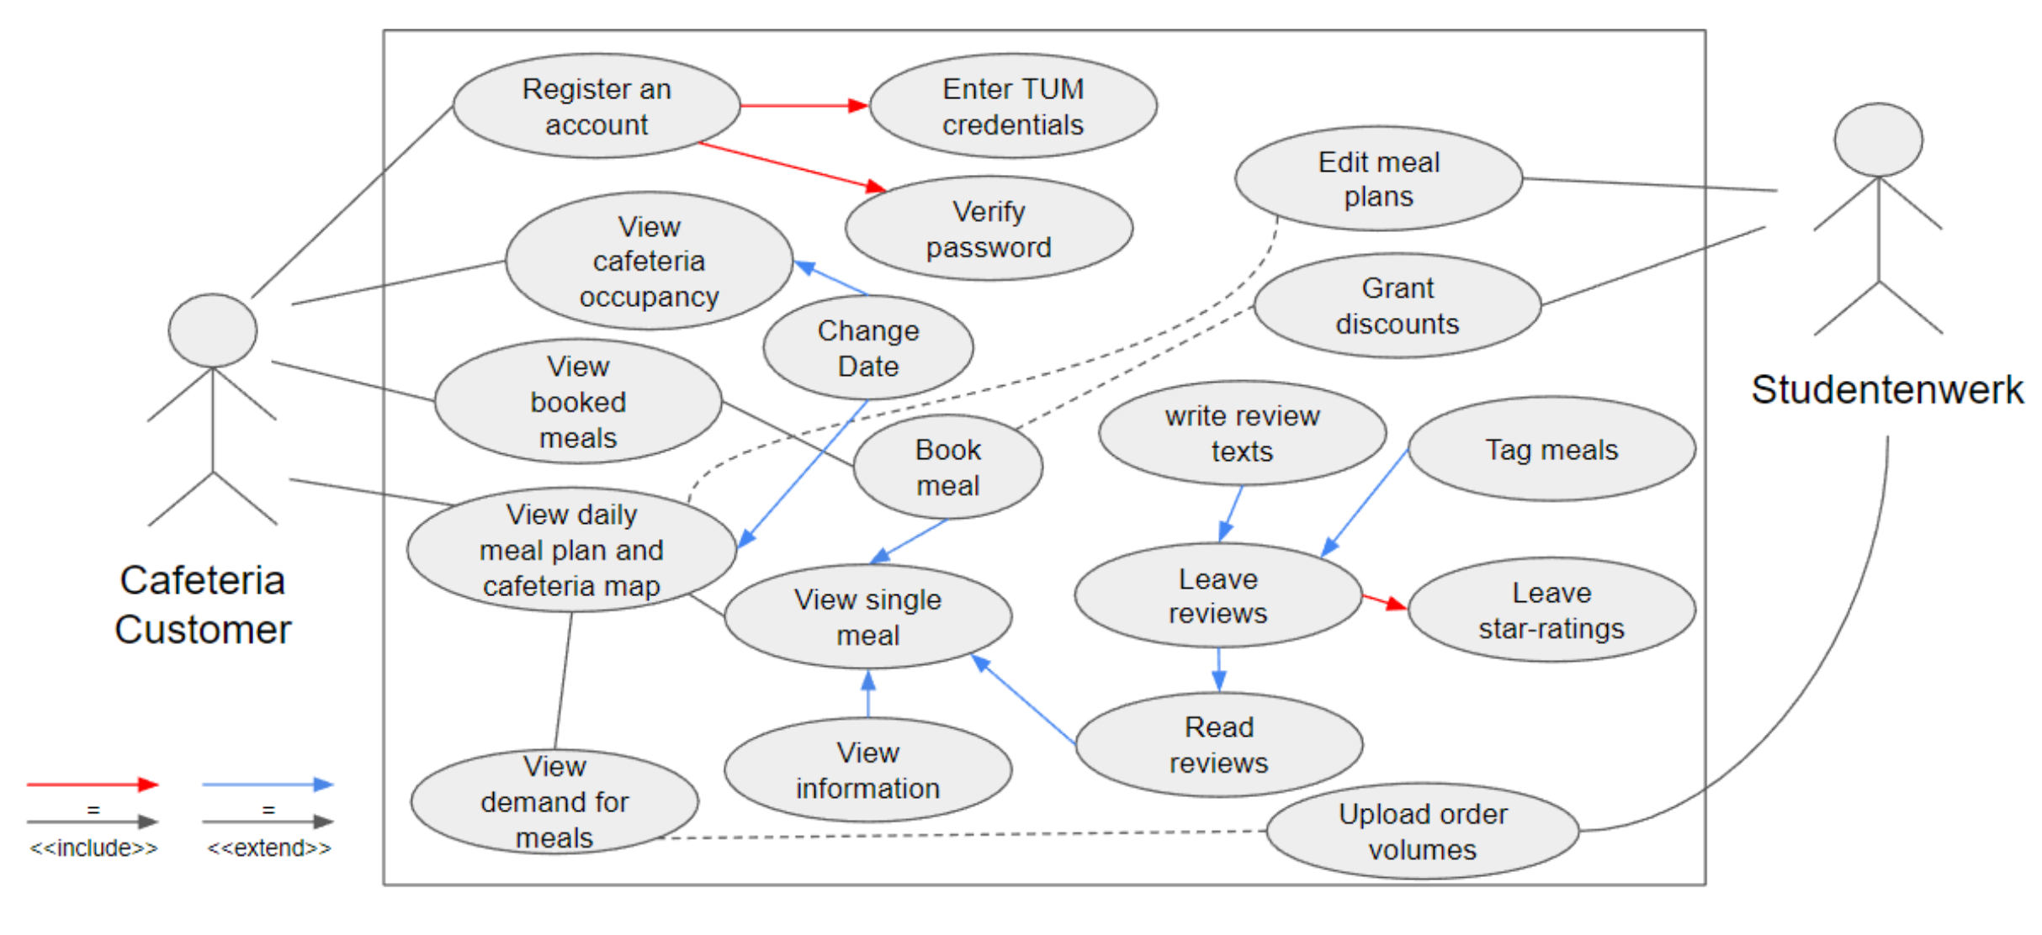



METHODOLOGY
ITERATION 2
1. Understand
User Context
Heuristic Evaluation
4. Evaluate
Against Requirements
2. Specify
User Requirements
FUNCTIONALITIES
occupancy graph
map of counters
UML Use Cases
Usability Goals
3. Design
Solutions
pre-booking discount
ratings & reviews
Visual Design
Hi-Fi Prototype
dish information
4

Slide 7





METHODOLOGY
ITERATION 3
1. Understand
User Context
Qualitative Evaluation
4. Evaluate
Against Requirements
2. Specify
User Requirements
3. Design
Solutions
Lo-Fi Web App
5

Slide 8

METHODOLOGY
ITERATION 4
1. Understand
User Context
Quantitative Evaluation
4. Evaluate
Against Requirements
2. Specify
User Requirements
3. Design
Solutions
Hi-Fi Web App
6

Slide 9
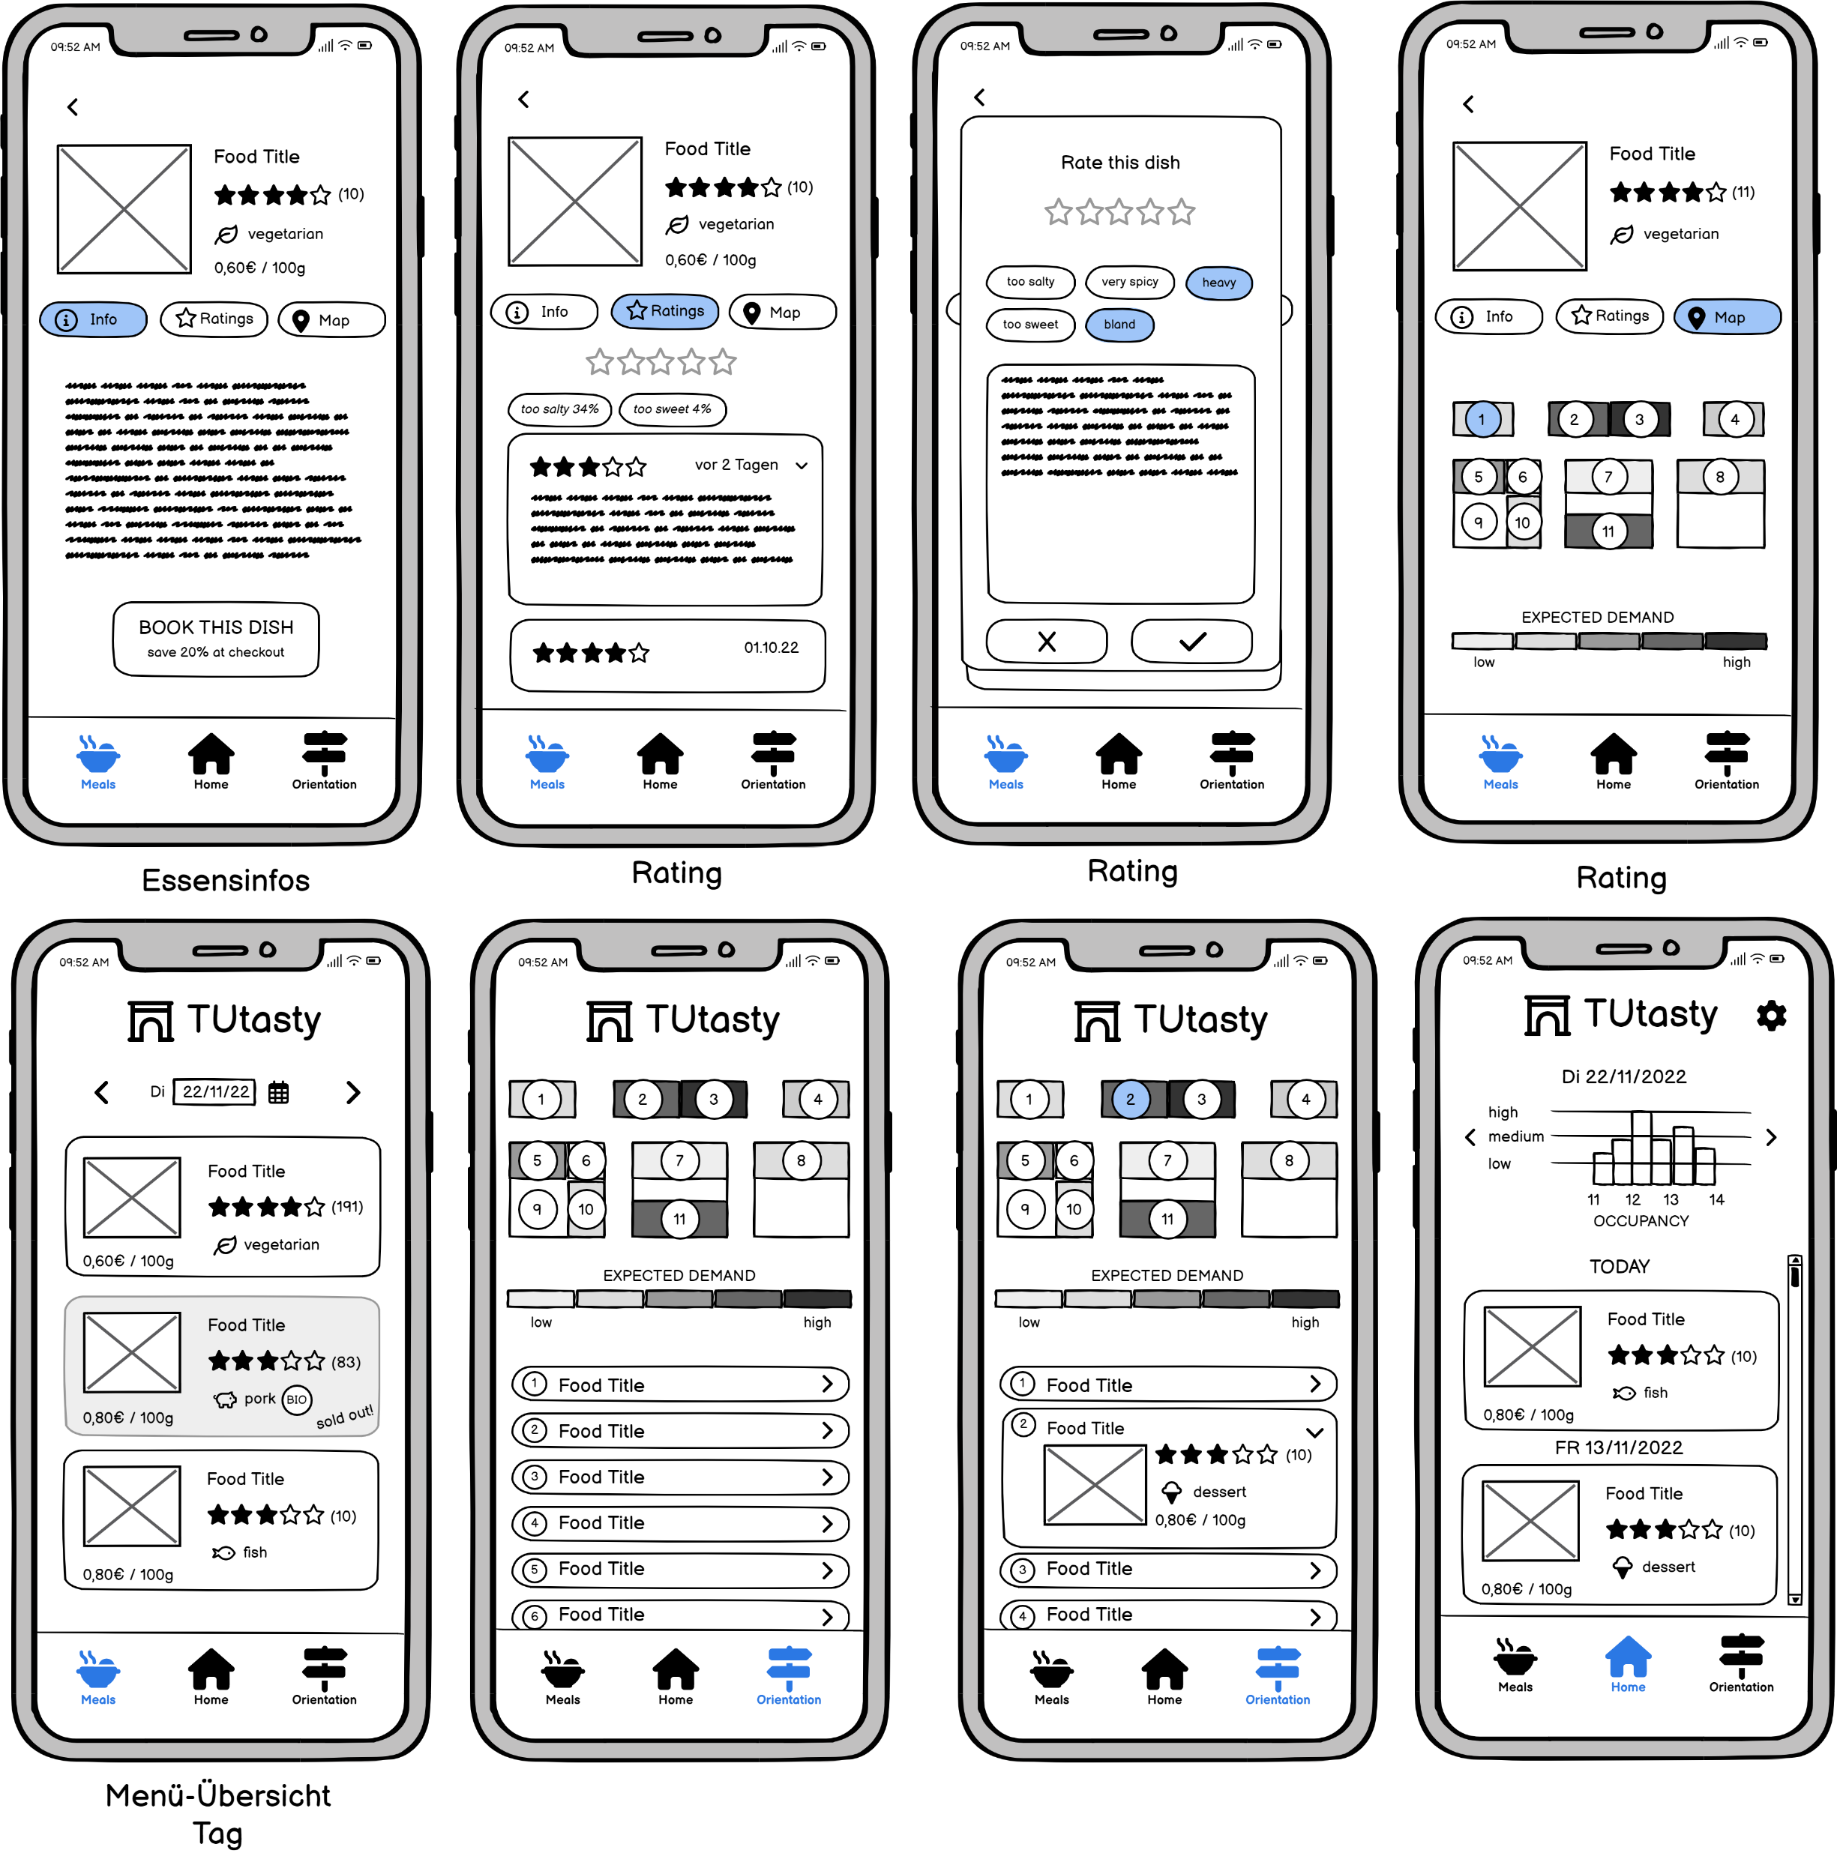
PAPER PROTOTYPE
Home Screen
Orientation Screen
Orientation Expansion
too much information
annoying to expand for every dish
7

Slide 10
PAPER PROTOTYPE
duplication of counter map
duplication of meals list
Meals Overview Screen
Meal Map Screen
Meal Info Screen
booking deadline unclear
8
Notes:
2. Duplication of dishes information
3. Booking deadline unclear
4. Booking button is hard to find

Slide 11
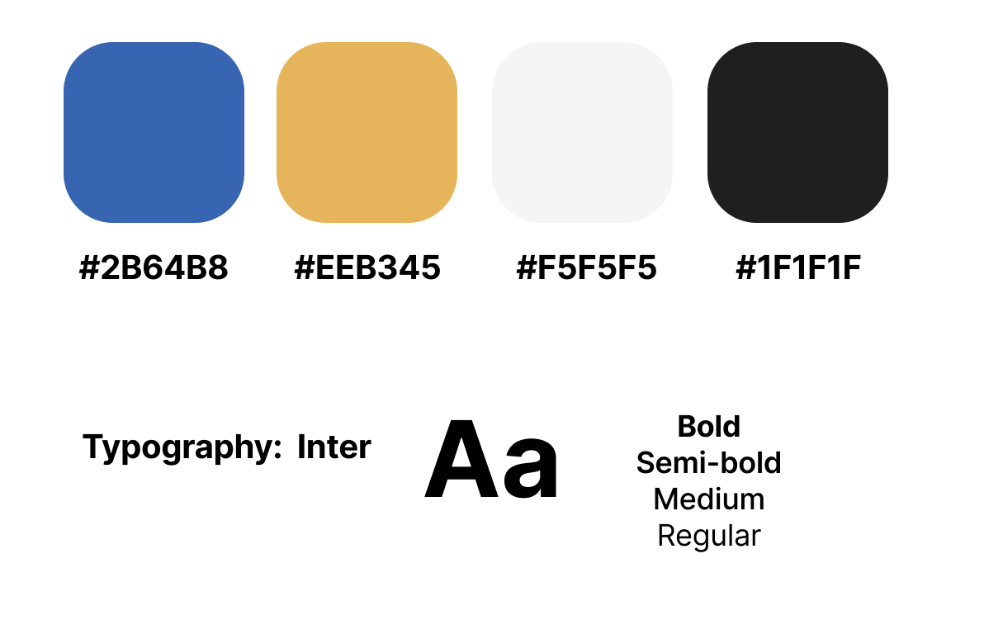


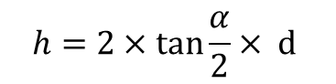
DESIGN STYLEGUIDE
Calculation of the minimum font size^{[2]}：
→ minimum: 7 pt
→ recommended: 10 pt
Complementary
Color
$$h=2×\tan{\frac{α}{2}× d}$$
Icons:
Material Design
Contrast Ratio:
(Conforms to ISO 9241-303)
5.76 : 1
9

Slide 12
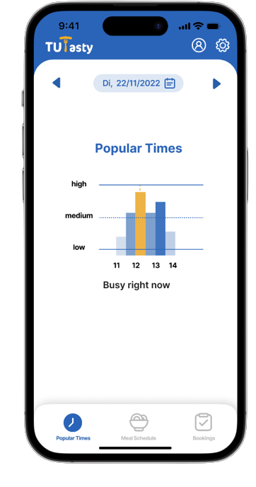
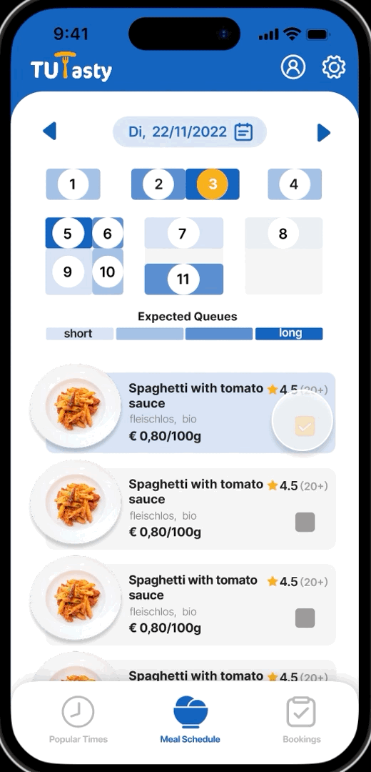
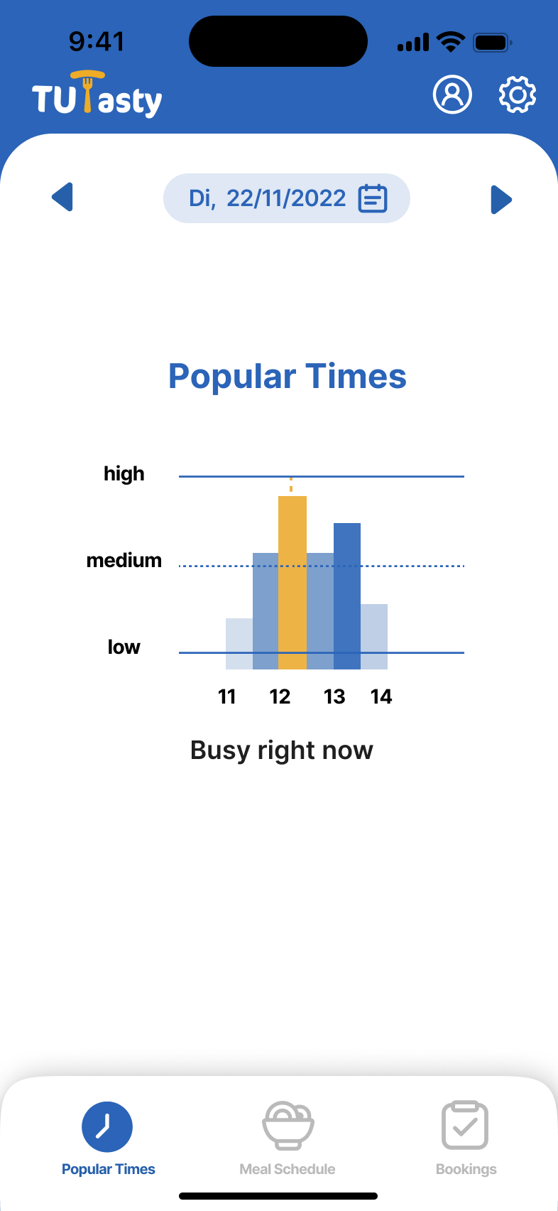
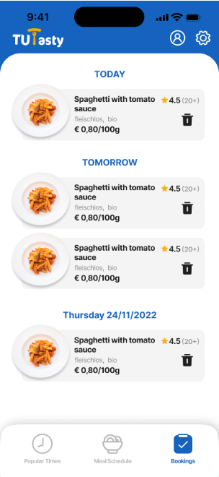
HI-FI PROTOTYPE
10

Slide 13
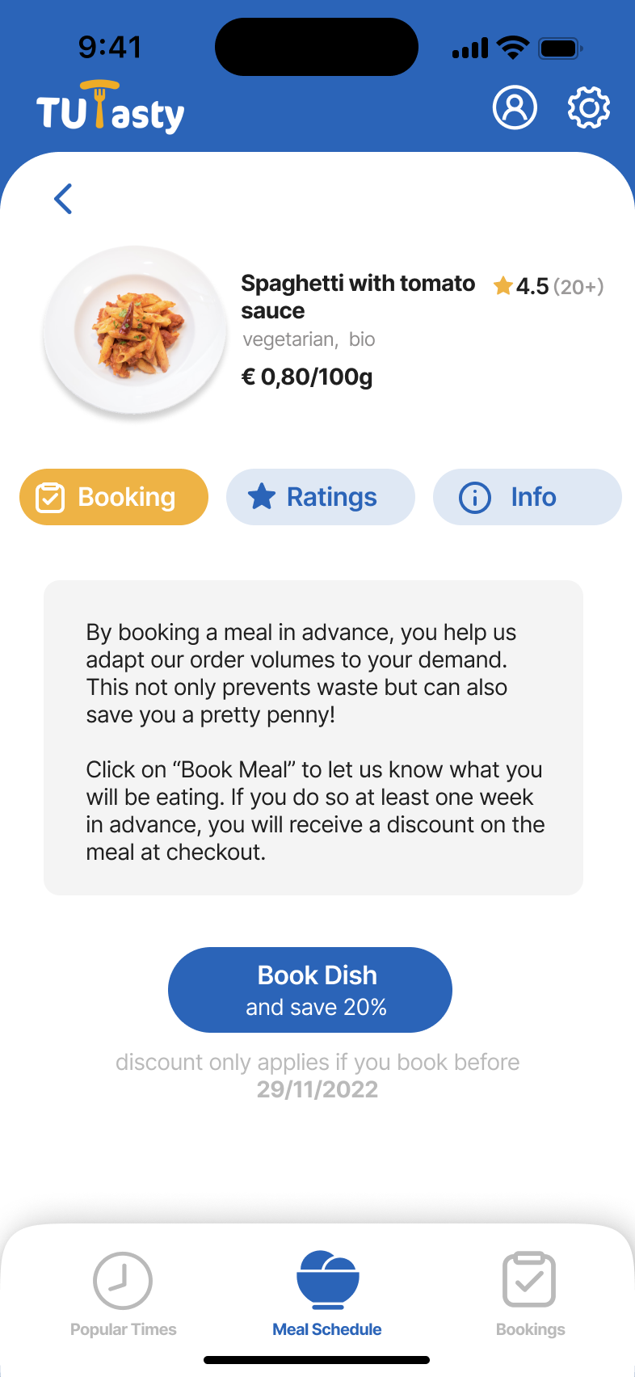
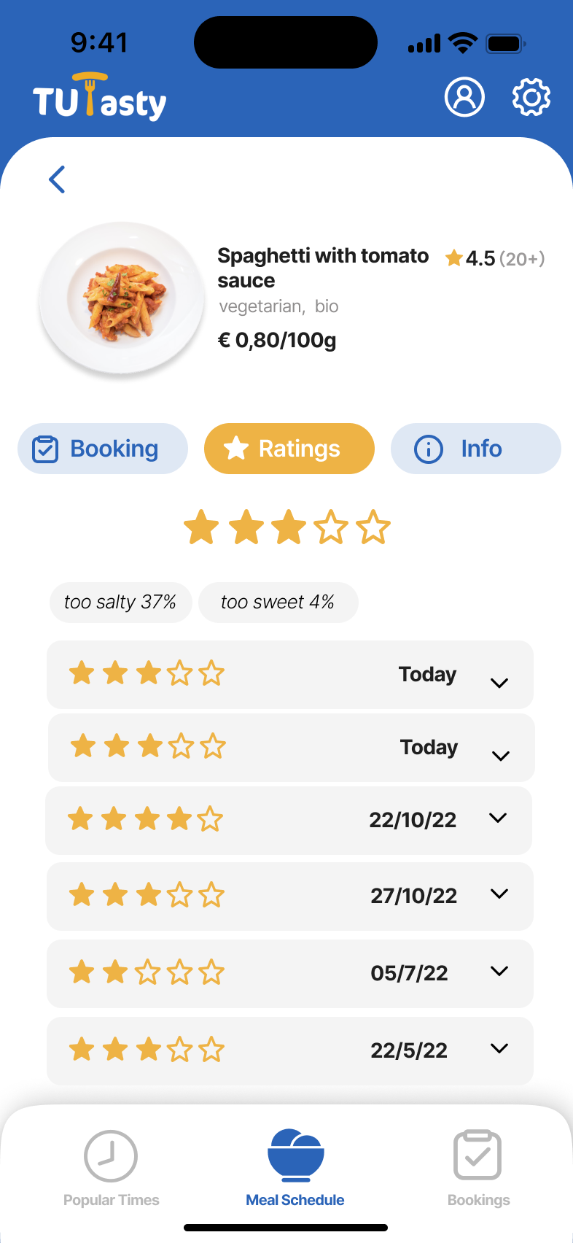
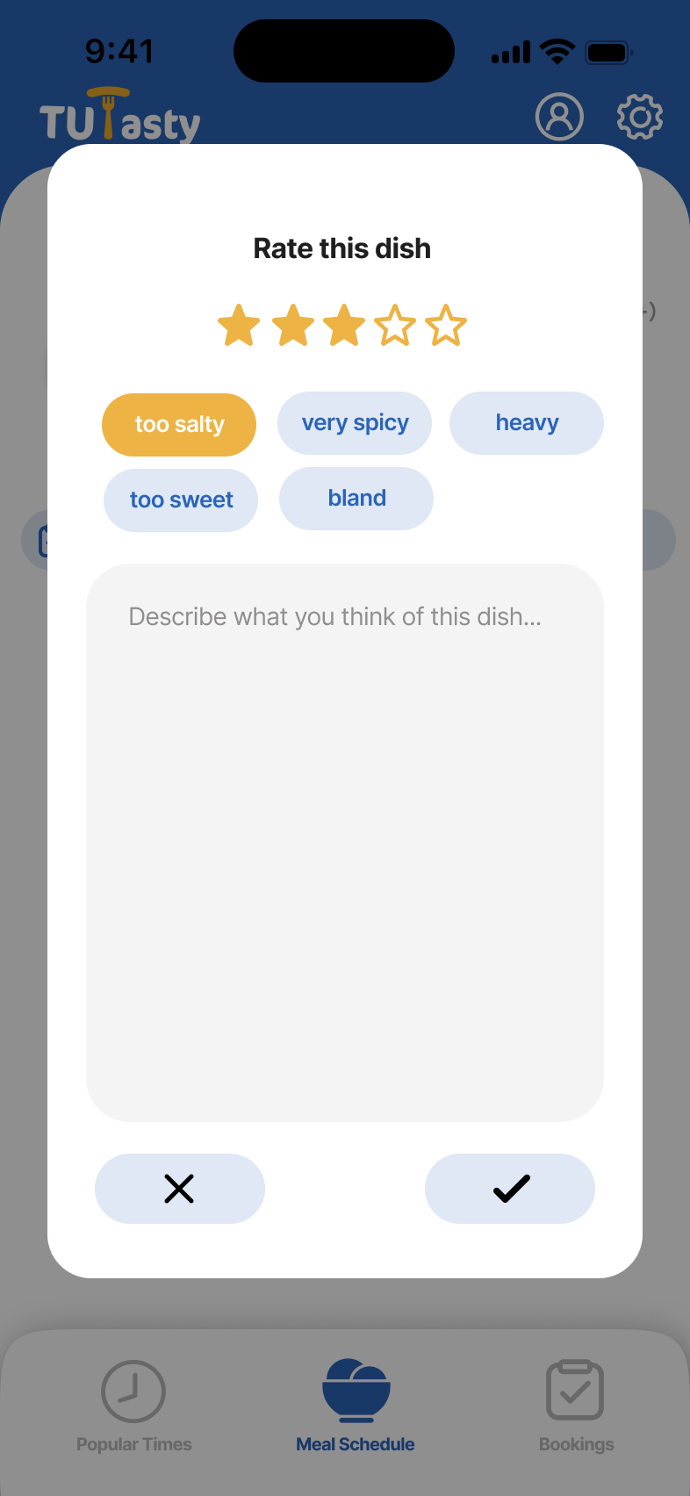
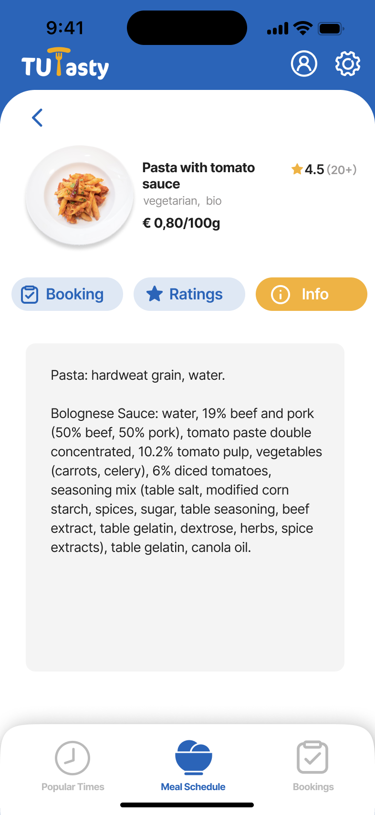
HI-FI PROTOTYPE
11

Slide 14
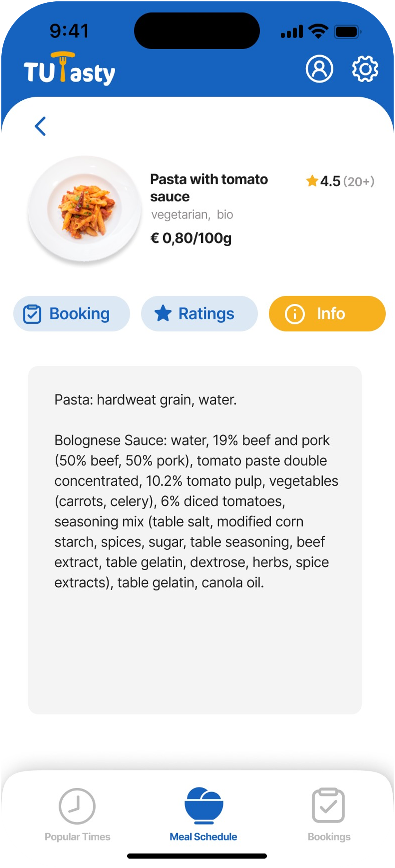
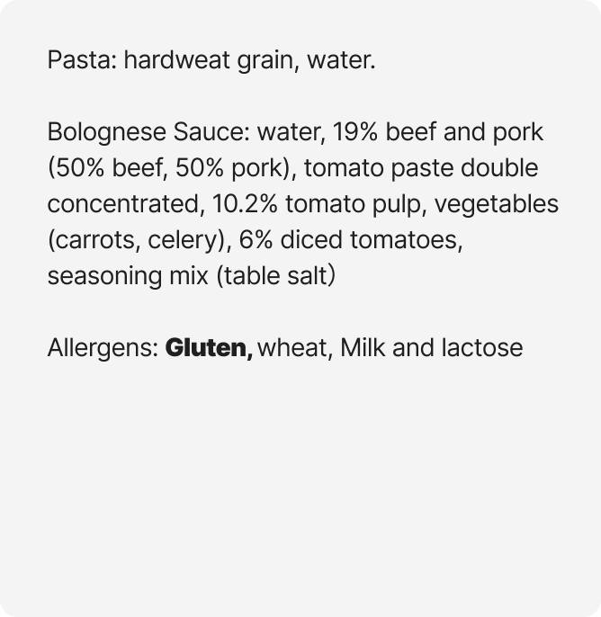

HEURISTIC EVALUATION *
* Evaluation by Team FunTravel
Visibility of system status should Highlight relevant allergens
IMPROVEMENT will be able to input relevant allergens on re-gistration or profile, marked bold on screen
12

Slide 15
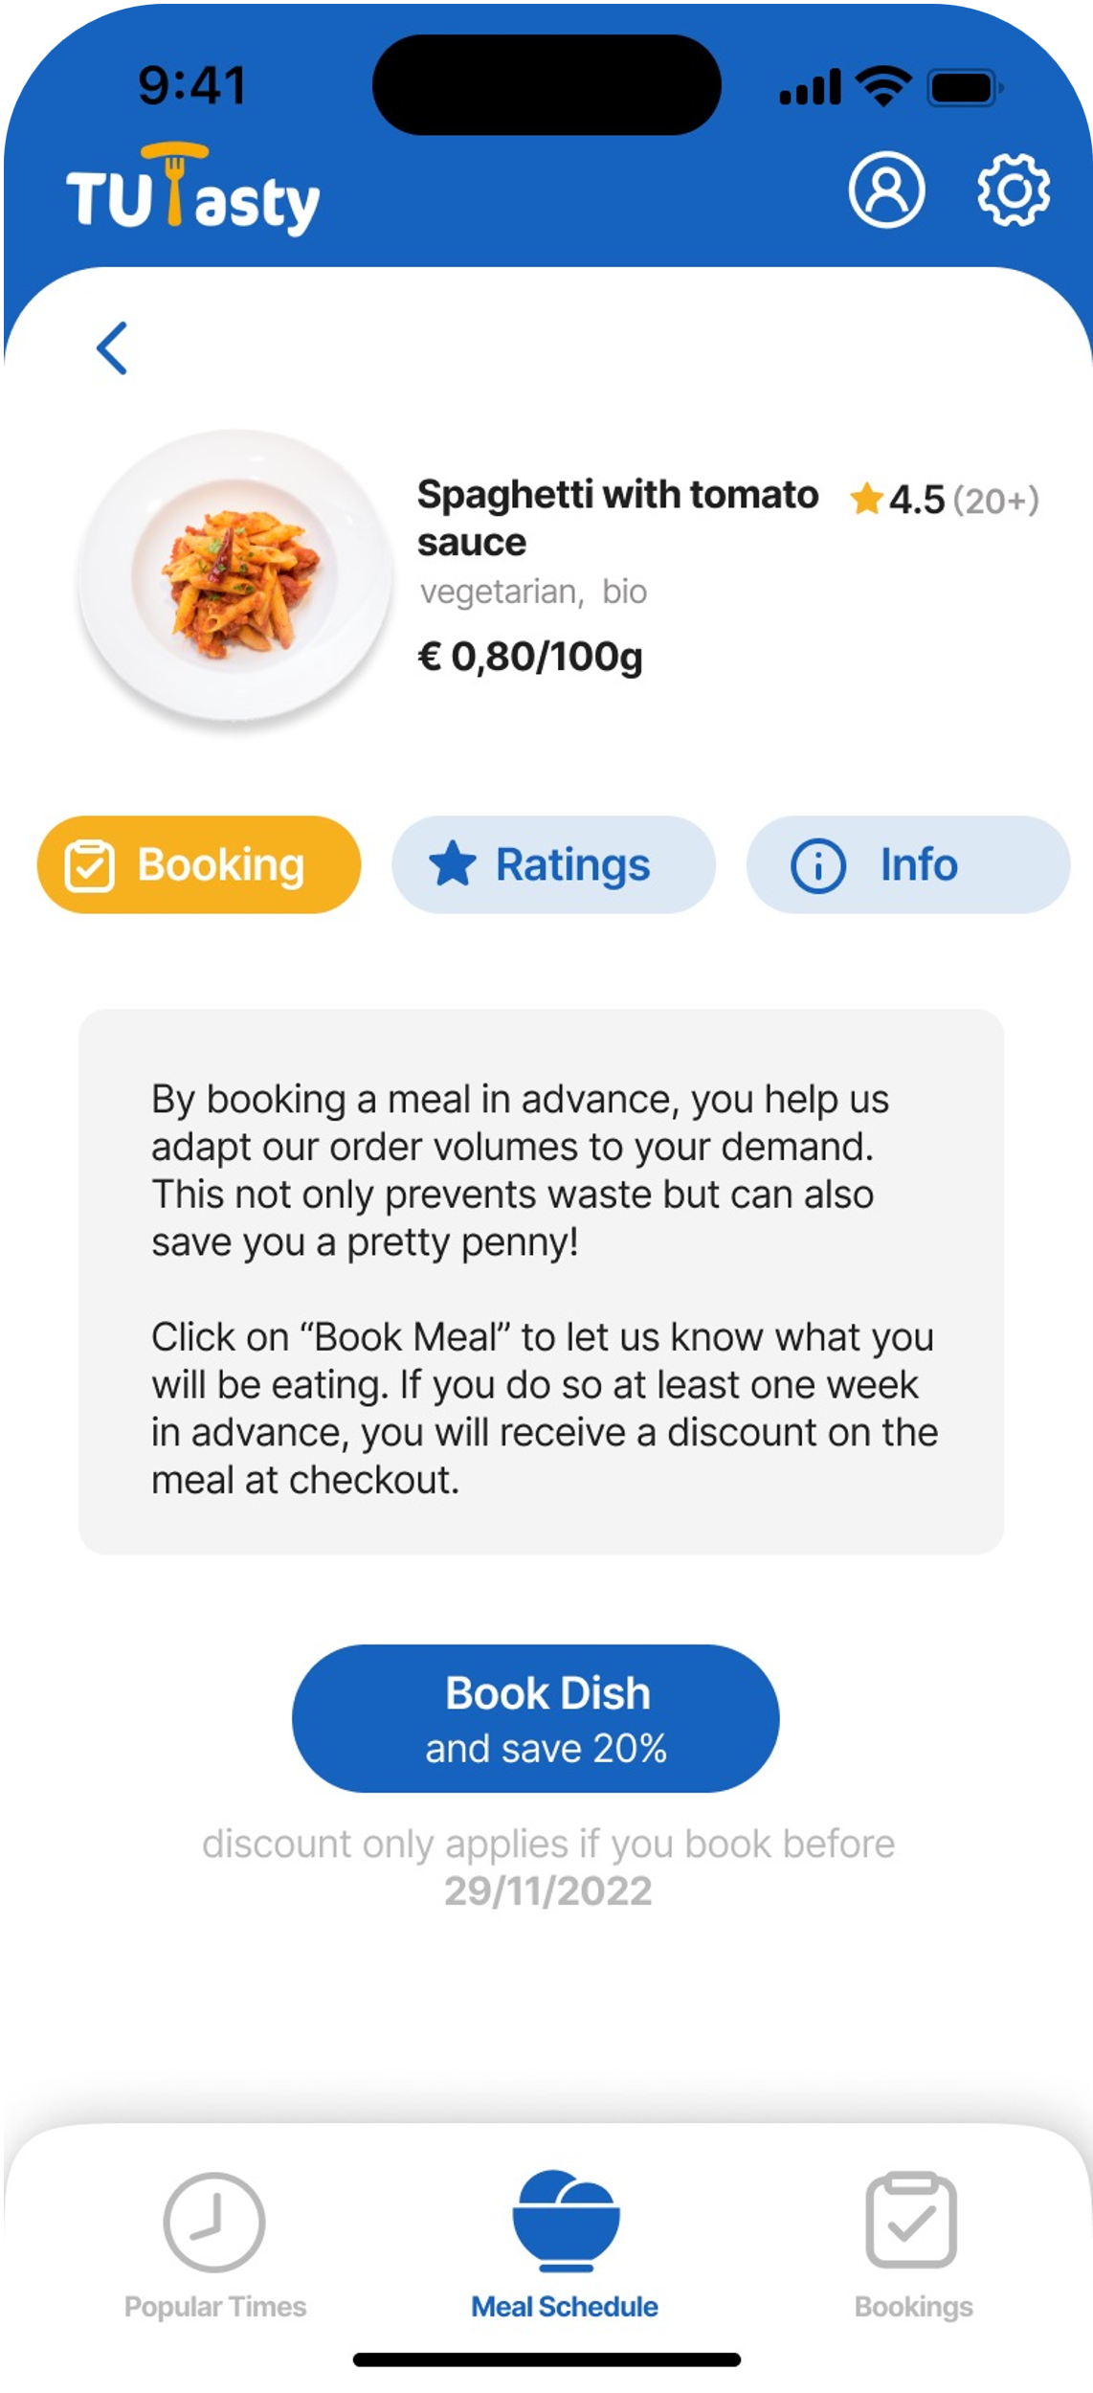
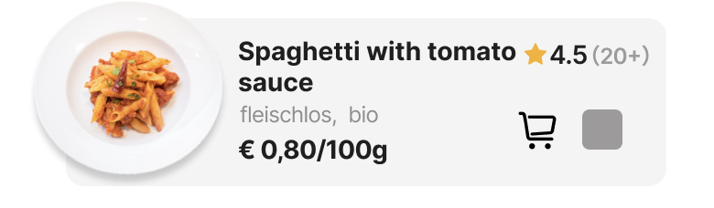
HEURISTIC EVALUATION *
* Evaluation by other experts
Flexibility and efficiency of use The reservation process is a bit inefficient, each time you need to go to the details page of each dish
IMPROVEMENT Added a fast booking feature
13

Slide 16
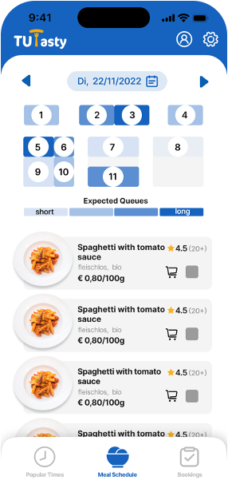
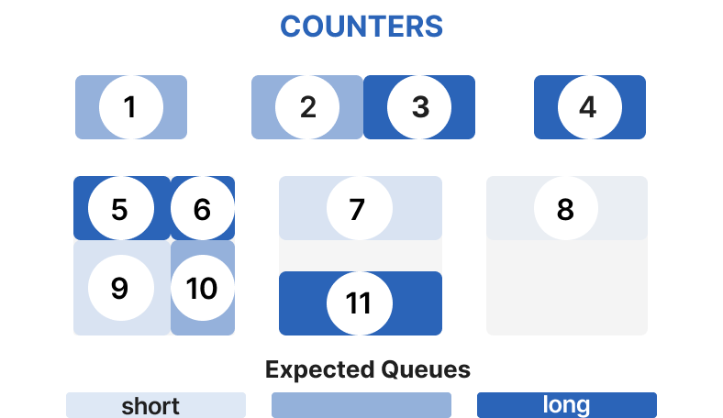
QUALITATIVE EVALUATION
FEEDBACK
Confused about the counter map
Four levels of "queues" not necessary
IMPROVEMENT
Added title
Changed to three levels
* [3 test subjects aged 24-27 (Ø 25.3 years)]
14

Slide 17
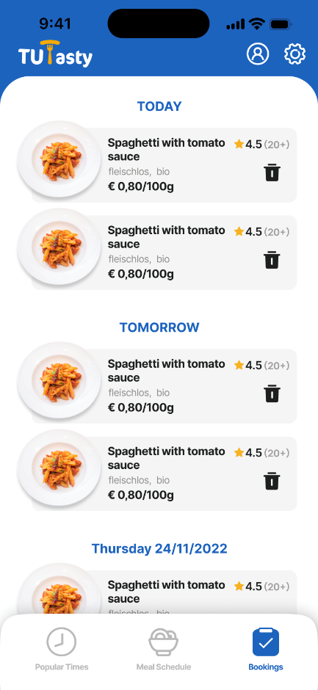
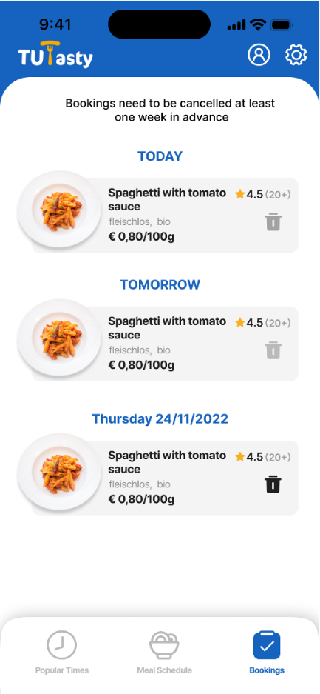
QUALITATIVE EVALUATION
FEEDBACK
“ It is not possible to distinguish if the current reservation is already non-cancellable.”
IMPROVEMENT
The icon turns gray when it is not cancelable
Added a confirmation pop-up
15

Slide 18
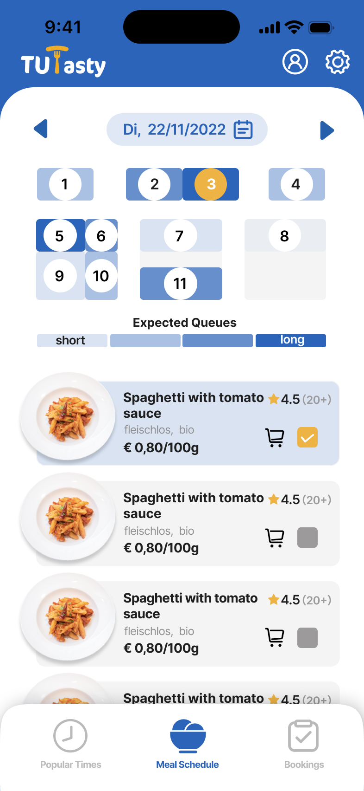
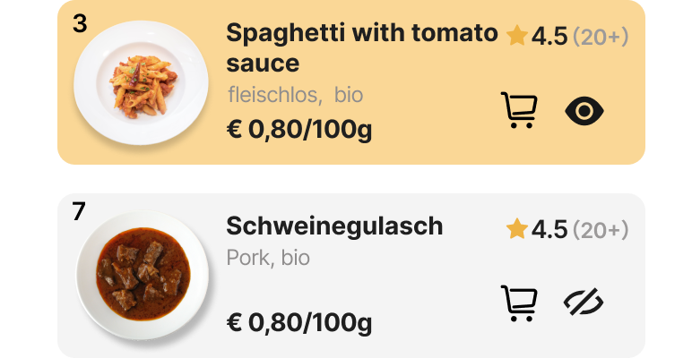
QUALITATIVE EVALUATION
FEEDBACK
Checkbox is not well correlated with the viewing location
Meaning of numbers is unclear
IMPROVEMENT
New icon, New color
Counter number added to each dish
16

Slide 19
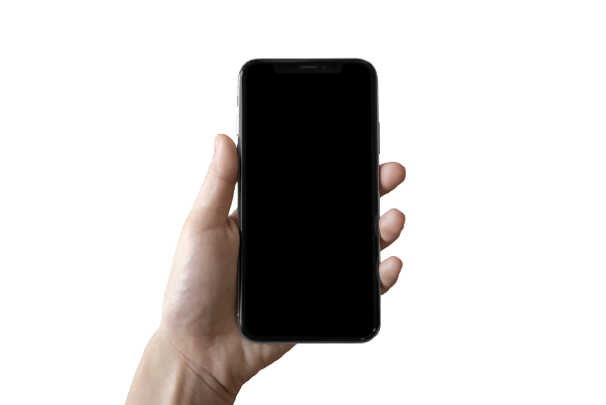
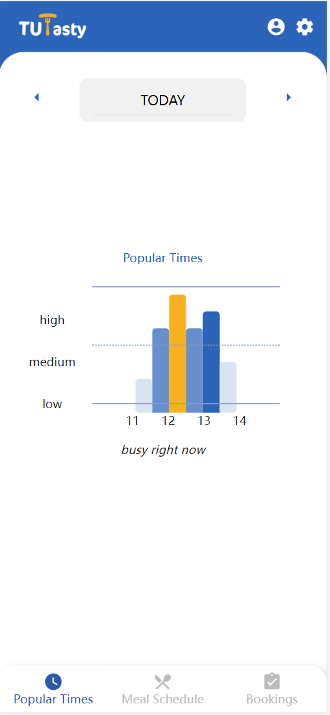
FINAL WEB PROTOTYPE
17

Slide 20
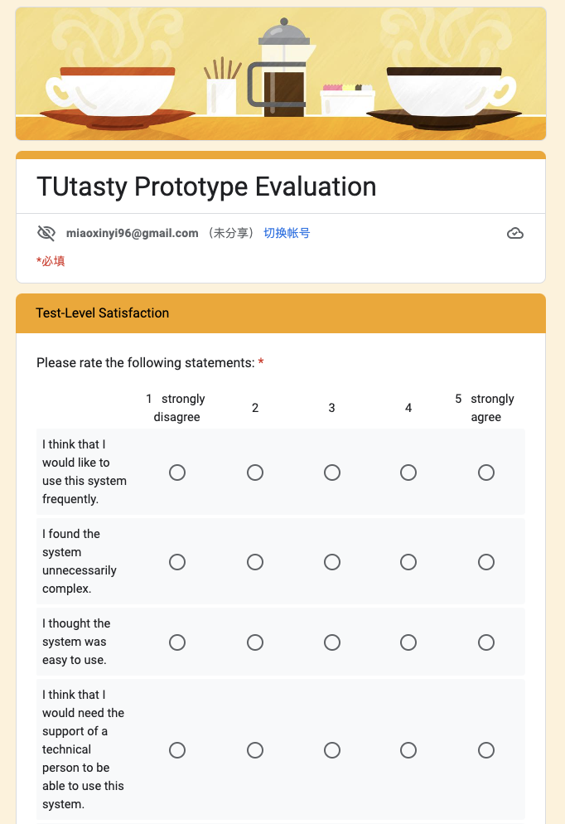
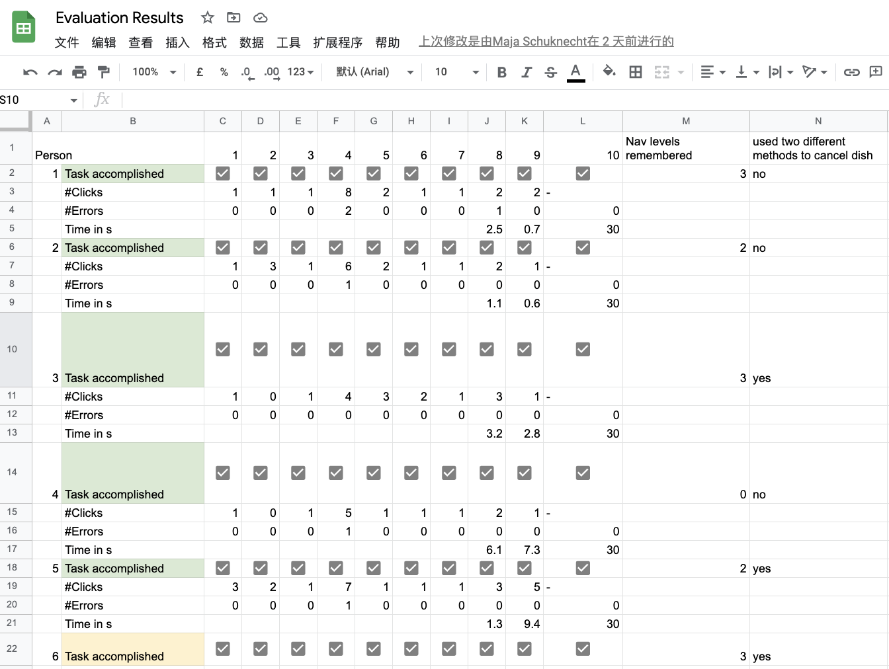
QUANTITATIVE EVALUATION
18

Slide 21


QUANTITATIVE EVALUATION
12 Hypotheses from the following goals:
10 Participants (f = 5; m = 4; d =1 )
Age
mean = 25,8 Years
Form 24-30 Years
Occupation
Student = 6, University Employee =1,
Tutor = 1, Worker =2
Frequency
60% > 2-4 times per week
1. Learnability ^{[3,4]}
2. Effectiveness ^{[4]}
3. Efficiency
4. Memorability
5. Errors
6. Subjective Satisfaction
19

Slide 22
QUANTITATIVE EVALUATION
OBJECTIVE
Goal | Hypothesis | Result
… | …
2. Effectiveness | 2.2 Average completion rate of >70% for all tasks completely performed by users | 100%
4. Memorability | 4.1 At least 70% of users can remember the three first-level navigation of the product after testing. | 60% < 70%
5. Errors | 5.1 average number of errors is at most 6 in fulfilling all tasks^{[5]} . | 2.6
 | 5.2 At most 40% of the subjects will make wrong click at the task - view location of dishes. | 70% > 40%
20

Slide 23
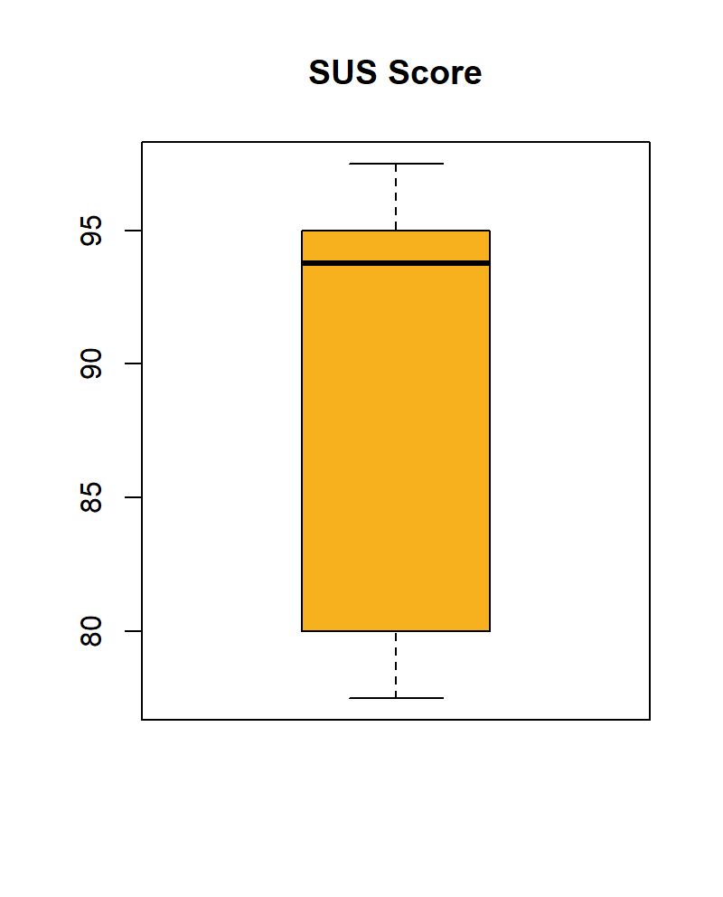
QUANTITATIVE EVALUATION
SUBJECTIVE
Test-level satisfaction
The average SUS^{[6]} score is 89.5
Over 85, so this prototype meets the “excellent” rating^{[6,7]}
Descriptive Statistics
 | Valid | Missing | Mean | Std.Deviation | Min. | Max.
SUS Score | 10 | 0 | 89.5 | 7.976 | 77.5 | 97.5
21

Slide 24
QUANTITATIVE EVALUATION
SUBJECTIVE
Goal | Hypothesis | Result
6. Subjective satisfaction | 6.1 The prototype achieves at least a rating of 6.5 out of 10 on average. | Score: 8.8
 | 6.2 SUS-Score exceeds a value of 70. | SUS-Score: 89.5
 | 6.3 The average Task Level Satisfaction^{[5,8]} does exceed a value of 5. | SEQ-Score : 6.52
22

Slide 25
THANK YOU!
Looking Forward to Your Feedback!

Slide 26
REFERENCES
[1] Lewis, Clayton. (1982). Using the "Thinking-aloud" Method in Cognitive Interface Design. S.1-6
[2] ISO 9241-303:2008 Ergonomics of human-system interaction — Part 303: Requirements for electronic visual displays
[3] ” Usability 101: Introduction to Usability”, https://www.nngroup.com/articles/usability-101-introduction-to-usability/, Retrieved on 12.01.2023
[4] ISO 9241-11 (2018) „Usability: Definitions and concepts”
[5] “Usability Metrics – A Guide To Quantify The Usability Of Any System”, https://usabilitygeek.com/usability-metrics-a-guide-to-quantify-system-usability/, access on 17.01.2022
[6] Bangor, Aaron; Kortum, Philip T.; Miller, James T. (2008): An Empirical Evaluation of the System Usability Scale. In: International Journal of Human-Computer Interaction 24 (6), S. 574–594
[7] “System Usability Scale (SUS)”, https://www.usability.gov/how-to-and-tools/methods/system-usability-scale.html, Retrieved on 12.01.2023
[8]”10 Things To Know About The Single Ease Question (SEQ)”, https://measuringu.com/seq10/, Retrieved on 12.01.2023
24

Slide 27
OVERVIEW
25

Slide 28
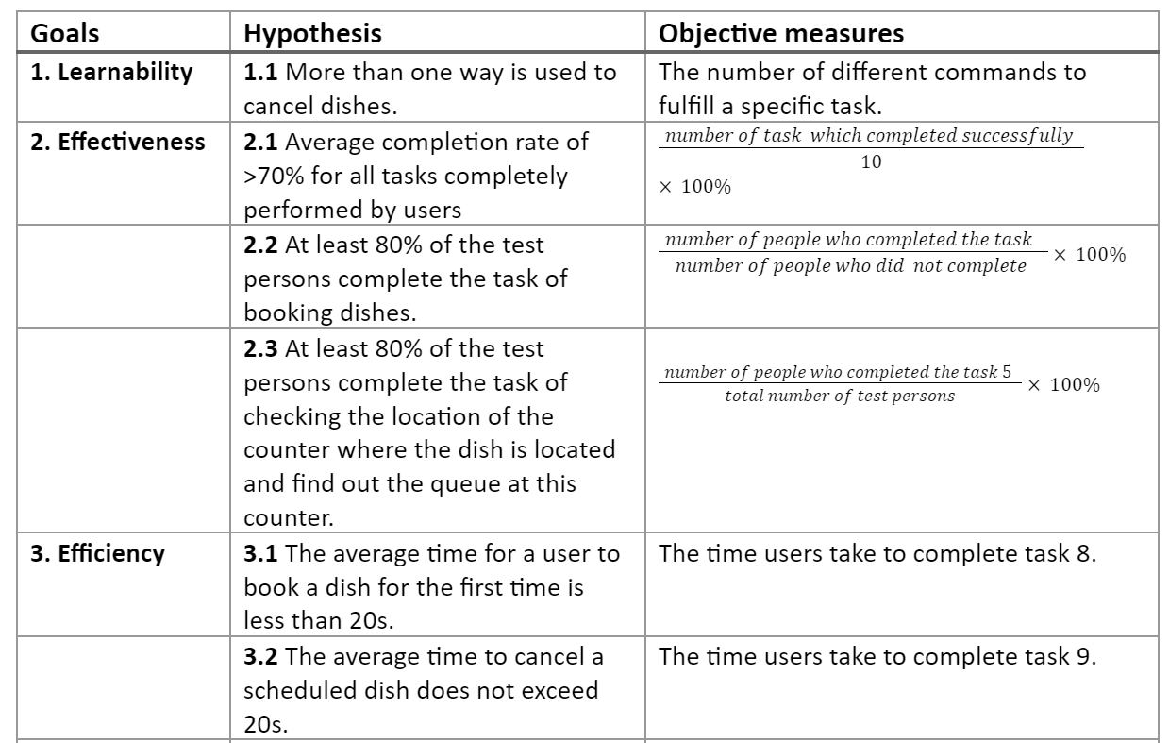
QUANTITATIVE EVALUATION – METRICS
26

Slide 29
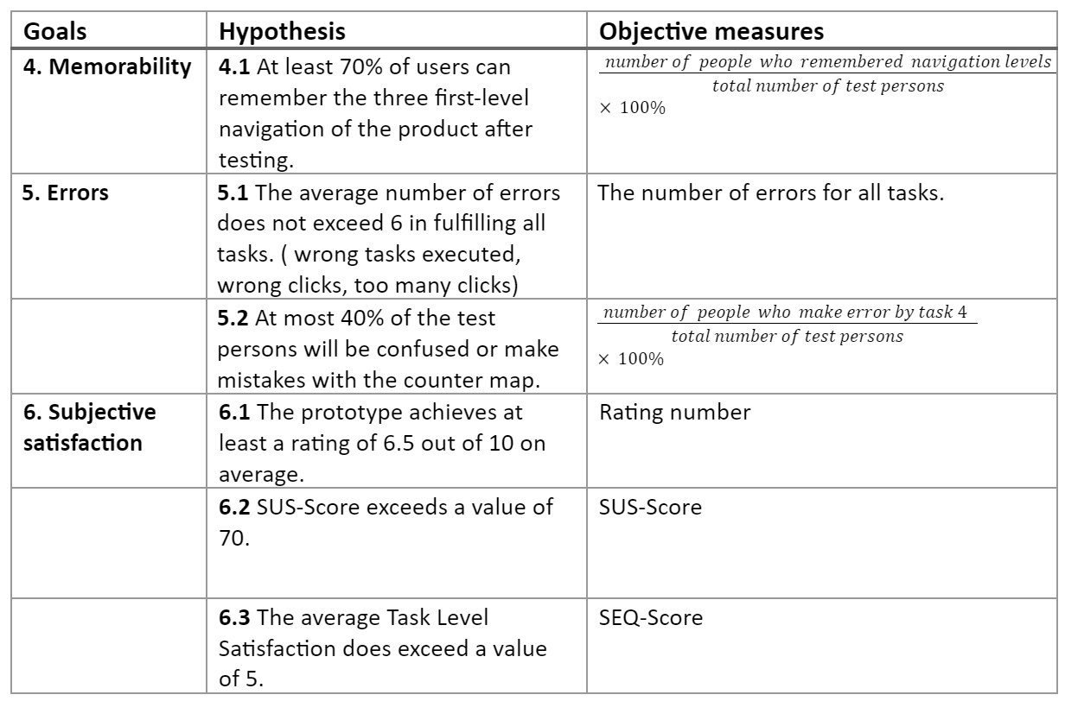
QUANTITATIVE EVALUATION – METRICS
27

